Slide 1




DEEPLINGO
Presented by:
Lester Anastacio
jason Alcantara
Gabriel Avila
Kerwin Catungal

Slide 2
PROBLEM
Problem:
Lack of Exposure
Teenagers might not be exposed to a wide variety of reading materials or diverse vocabularies that would help them encounter new words and see how synonyms and antonyms are used in different contexts. Limited reading habits can contribute to limited word knowledge.
Impact:
Reduced Critical Thinking
A strong vocabulary is directly tied to critical thinking skills. If teenagers struggle with language nuances, it can hinder their ability to analyze complex ideas, identify key differences, and make informed decisions.
Problem:
Dependence on Technology
Due to growth in digital communication (texts, social media, etc.) teenagers may become more dependent on abbreviations, slang, and informal language.
Impact:
Limited exposure to a variety of reading materials
Teenagers often aren't challenged with a range of reading materials that force them to be mindful of their vocabulary and comprehension. They often gravitate towards reading content that is easily consumable, such as social media, memes, or entertainment, that does not require them to think deeply or use complex vocabulary.

Slide 3
RATIONALE
The DeepLingo Dictionary application is using a contiguous container which is the QVector<WordEntry> in which is located within a WordStorage singleton as the main in-memory data structure and such a decision ensures very good cache locality and an amortized O(1) time complexity for adding new records and although the UI layer manipulates entities like QListWidget for visualization, the core data model is based on QVector and the manner in which search and retrieval operations are presently implemented such as the Function::searchWord along with the filtering routines (wordsForLetter), necessitates a linear scan of all O(n) words in the store, thus the time complexity of word lookups is O(n). The space complexity of these operations is O(n + s) with being the temporary storage for the result lists, while the persistent memory is proportional to the total number of characters across all the WordEntry fields O(total characters ‌ ‍​‍​‌‍​‍‌stored).

Slide 4


LEARNING OBJECTIVES
To make the app more engaging by adding features like the Word of the Day challenge.
To develop a functional dictionary system with interactive features.
To apply object-oriented programming and interface design concepts.
To strengthen collaboration and problem-solving through group development.

Slide 5

OVERVIEW
  A dictionary application that provides definitions, translations, and user engagement tools.
  Developed to make word learning more interactive and organized.
  Allows users to save words important to them for personalized learning

Slide 6
KEY FEATURES
  Dictionary Core: Word search, language selection, history log, Word Details Window, Browse Words, Add Custom Words
  Utility: Sorting system, calendar/time tracking, Notes , Profile Window

Slide 7
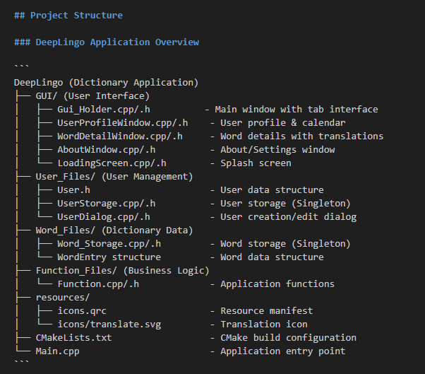
SYSTEM ARCHITECTURE

Slide 8
VIDEO DEMO LINK:
https://drive.google.com/drive/folders/1nWIGEQhp0OjXrOaZHgLyJP65wL9gZGjS

Slide 9
THANK YOU

